Slide 1
Back-end Engineering
Learning Management System
Team Details:
Aarushi Sharma (2310990258)
Geetanshi Singla (2310990265)
Aditya Goyal (2310990266)
Chaitanya Rana (2310990316)
Faculty Coordinator: Mr. Rahul Rajput
:
Chitkara University Institute of Engineering and Technology,
Chitkara University, Punjab

Slide 2
Table of Contents
Introduction
Problem Statement
Technical Details
Advantages
Key Features
Project Highlights
Conclusion
References/Links used

Slide 3
Introduction
A Learning Management System (LMS) is a digital platform designed to simplify the process of teaching and learning. It allows educators to create and manage courses, while learners can easily access study materials, track their progress, and engage in an interactive learning environment. The system brings together all essential elements of education—courses, assessments, and communication—into one unified space, making learning more organized, efficient, and accessible for everyone.
Key Points
Centralized platform for teaching & learning
Easy access to courses and study materials
Enables tracking of learner’s progress
Supports assessments and feedback
Makes education more organized & interactive

Slide 4
Problem Statement
In today’s digital era, the demand for online education and training is increasing rapidly. However, many existing learning platforms still face significant challenges that affect both learners and educators. Learning materials are often scattered across different sources, making it difficult for students to find and access content in a structured manner. Limited interactivity reduces student engagement, leading to poor learning outcomes.
Educators also encounter difficulties in managing courses, conducting assessments, and monitoring student performance efficiently. Traditional systems are often complex, not user-friendly, and lack flexibility to adapt to diverse learning needs. These limitations create barriers to effective learning and highlight the need for a unified platform that streamlines the entire process of teaching and learning.

Slide 5
Technical Details
Backend
Node.js & Express.js → Handles server-side logic and REST API endpoints
JWT Authentication → Secure user login and session management
Mongoose → Simplifies MongoDB operations with schema-based modeling
API Layer → Provides structured endpoints for courses, users, and assessments
Frontend / UI
React.js → Component-based, fast, and responsive interface
React Router → Smooth navigation across different views (dashboard, courses, etc.)
Axios / Fetch API → For communication with backend APIs
Tailwind CSS → Utility-first framework for modern, responsive, and clean design
Database
MongoDB (NoSQL) → Stores user data, course content, and progress flexibly

Slide 6
Advantages
Centralized platform for managing courses, users, and learning materials
User-friendly interface for both educators and learners
Real-time progress tracking and performance monitoring
Scalable architecture to handle increasing users and courses
Flexible database design supporting diverse learning content
Secure authentication and role-based access control
Cross-platform compatibility with responsive design

Slide 7
Key Features
User Registration & Authentication
Implemented using JWT-based authentication with secure login and signup APIs.
Provides role-based access for students and instructors.
Course Management
CRUD operations on courses handled via Express.js and MongoDB (Mongoose models).
Instructors can create, update, and delete courses, while students can browse and enroll.
Learning Content and Assignments
Courses include structured lessons, resources, and assignments stored in MongoDB.
Students can submit assignments, and instructors can review and grade them.

Slide 8

Project Highlights

Slide 9
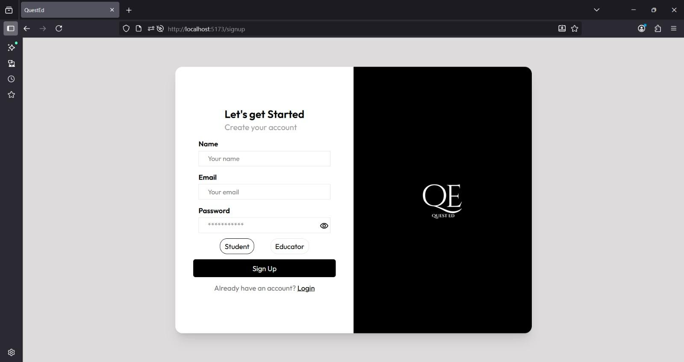
Project Highlights

Slide 10
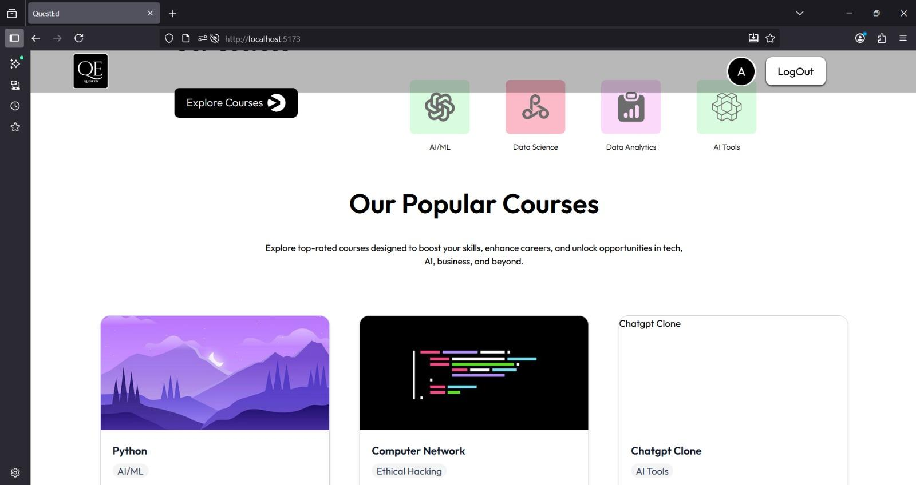
Project Highlights

Slide 11
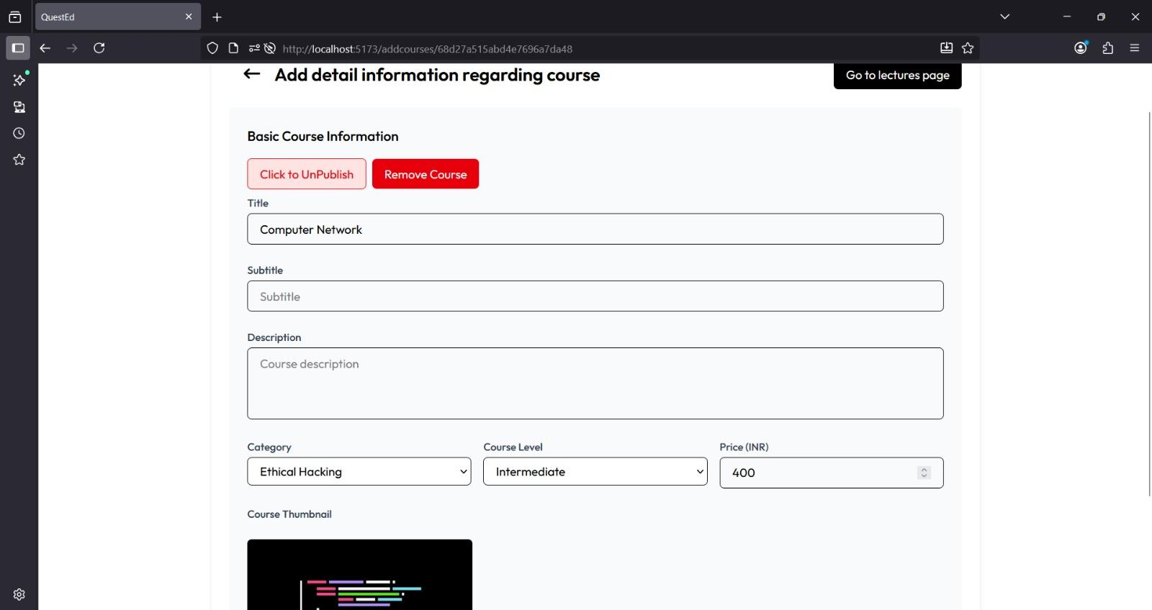
Project Highlights

Slide 12
Conclusion
The Learning Management System provides a modern, scalable, and user-friendly platform that simplifies the management of courses and learning resources. It enhances accessibility, collaboration, and personalized learning experiences for both students and instructors. Through this project, we gained valuable hands-on experience with React, component-based architecture, state management, and API integration. In the future, advanced features such as AI-powered recommendations, detailed analytics, and mobile-friendly support can be added to make the system more efficient and impactful. By combining technology with education, our LMS fosters continuous learning, builds engagement, and contributes to overall academic growth.

Slide 13
References
Backend & Frameworks
Express.js → https://expressjs.com/
Node.js → https://nodejs.org/
Database
MongoDB → https://www.mongodb.com/
Mongoose (MongoDB ODM) → https://mongoosejs.com/
Frontend
React → https://react.dev
React Router → https://reactrouter.com/
REST API Guide → https://restfulapi.net/

Slide 14


